Slide 1

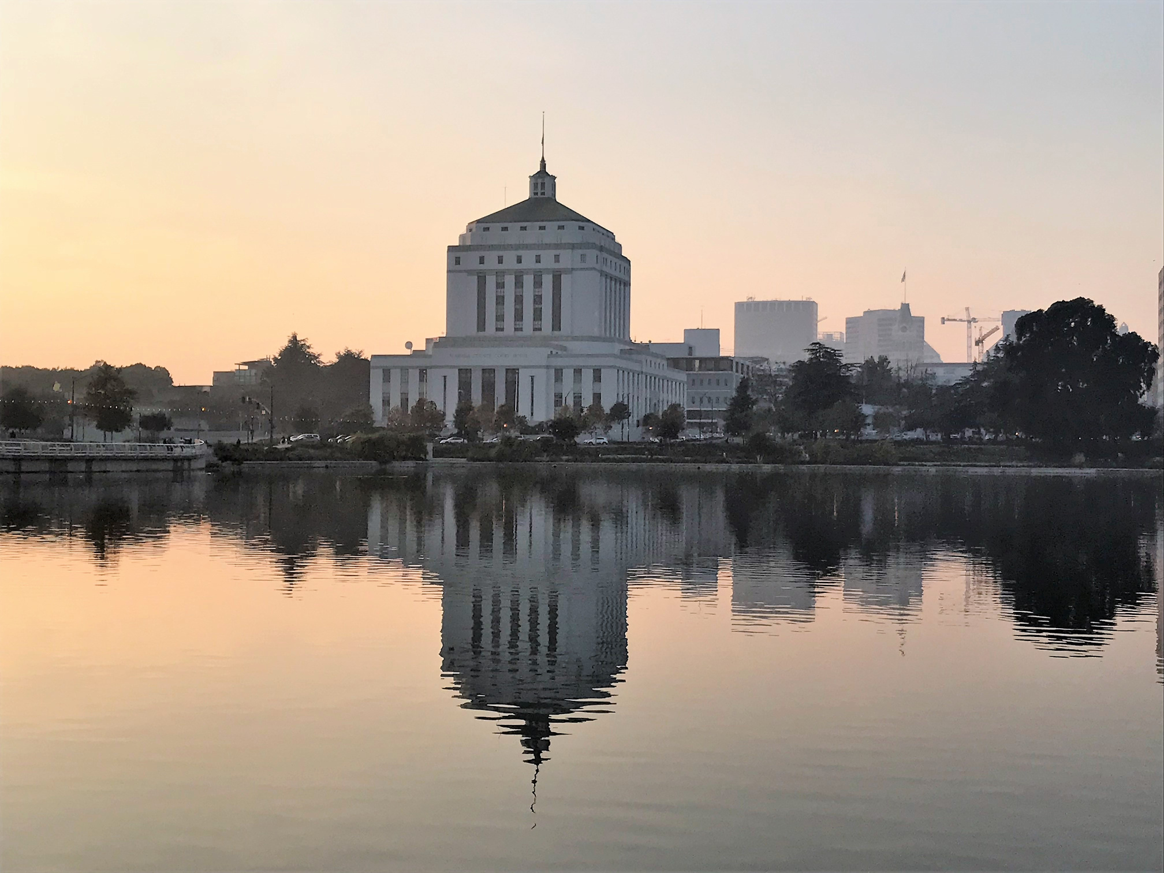
Issue Date: April 1, 2026
RFP Number: SC 1801.2026.2.ZX
ALAMEDA COUNTY SUPERIOR COURT
MANAGED
PRINT
SERVICES
Pre-Proposal Conference
April 8, 2026

Slide 2
AGENDA
  1. Timeline and Important Dates
  2. Background Information
  3. SOW Requirements
  4. Technical Proposal
  5. Cost Proposal
  6. Submission of Proposals
  7. Questions

Slide 3
Apr. 1, 2026
RFP Issued
Apr. 8, 2026
Pre-Proposal Conference
Email All Questions To:
bidquestions@alameda.courts.ca.gov
Questions and answers will be posted on April 20th (estimate).
Apr. 13, 2025
Deadline for questions
Apr. 30, 2026
Proposals due
TIMELINE
May 27, 2026
Public Opening of Cost Proposals
Jun. 1, 2026
Notice of Intent to Award
Jun. 2 – Jul. 1, 2026
Negotiations and Execution of Contract
Aug 1, 2026 – Jul. 31, 2027
1st Option Term: August 1, 2027 - July 31, 2028
2nd Option Term: August 1, 2028 - July 31, 2029
3rd Option Term: August 1, 2029 - July 31, 2030
4th Option Term: August 1, 2030 - July 31, 2031
Contract start date and expiration date
With an option to extend through Aug. 31, 2031

Slide 4
BACKGROUND INFORMATION
Alameda County Superior Court
Managed Print Services
WHO?
WHAT?
WHY?
Superior Court of California, County of Alameda
  Managed Print Services
  135 Networked Printers
  652 Non-networked Printers

Slide 5

SOW REQUIREMENTS
STATEMENT OF WORK
DESCRIPTION OF GOODS AND OR SERVICES (Section 2.1)
  Located and identify printers under this agreement
  Maintain a fixed asset inventory of all printers
  Provide all labor, parts, and supplies (excluding paper) at no additional cost
  Supply and replace OEM toner cartridges as needed
  Travel and parking fees are not paid or reimbursed by the Court
  Make service calls 8:00 AM – 5:00PM, Monday-Friday, excluding holidays
  Respond within 4 hours and replace defective parts with 24 hours
  Test requirement after repairs and track service request
  Report monthly page counts and mange disposal and recycling of parts
  Provide monthly asset report with printer details and locations
PERFORMANCE
PRETRIAL POPULATION

Slide 6
SOW REQUIREMENTS CONT.
STATEMENT OF WORK
SUPPORT SERVICES (Section 2.2)
PRETRIAL POPULATION
  Support Services and Service Levels
    Level 1 – Responding to technical inquires via email or phone
    Level 2 – Use of Technical support specialist
    Level 3 – Use of back up engineering and technical support
  Reporting Date
  Resolution Period and Severity Level
  Severity Level
  Standard M&S Hours
  Technical Support Incident

Slide 7
Attachment 14
TECHNICAL PROPOSAL QUESTIONS
Prospective Bidder must respond on a separate answer sheet to the questions listed in this attachment
TECHNICAL PROPOSAL
Other Forms, Attachments and Certifications
Refer to the Check List for other required forms and attachments.
Licenses and certifications: Business, Good Standing

Slide 8
COST PROPOSAL
COST PROPOSAL ATTACHMENT 15
  Complete columns E through I on rows 8 and 29 for each required cost under in the Cost Proposal
  Total estimated contracted amount in column G on rows 36 will be automatically calculated
Each Bidder must submit a completed Cost Proposal utilizing the Cost Proposal attachment.
GENERAL TIPS
  Include ALL required costs for the contract. Any required costs not included and identified during contract negotiations may result in a cancellation of award

Slide 9
SUBMISSION OF PROPOSALS
SUBMITTING YOUR PROPOSAL
  Proposals must be submitted by April 30th at 2:00pm Pacific Time.
  Proposals must be submitted in 2 separate emails: (1) Technical Proposal and (2) Cost Proposal.
  Proposal must be emailed to bidquestions@alameda.courts.ca.gov
  The subject line of the email must include the RFP title and number.

Slide 10
QUESTIONS
Email additional questions to:
bidquestions@alameda.courts.ca.gov
Questions must be submitted via email by April 13th
Deadline to submit proposals is
April 30th 2:00PM

